Slide 1


COVID 19 Detection Through Radiograph Images
Using Deep Learning Algorithm
Alpas, Michael (malpas2@illinois.edu)
Ahmad, Wasique (wasique2@illinois.edu)
Singh, Mohit (mohits3@illinois.edu)
Yadav, Upendra Singh (usyadav2@illinois.edu)
Team 1233
Course : CS 598 Deep Learning for Health Care – Spring 2021
Professor : Jimeng Sun

Slide 2

Agenda
Project Introduction
Methods and Approaches
Results
Discussion
References
CS 598/Team 1233

Slide 3
Project Introduction
Background:
  Chest X-ray is a fast and effective diagnostic method for COVID-19 detection
  Many deep learning models have been developed to detect Covid-19
    Convolutional Neural Network (CNNInceptionV3)
    ResNet 50, ResNet152, Machine learning models: SVM, Logistic Regression, Decision Tree, etc
  Deep Learning (DL) framework: PyTorch
  Cloud computing platform: AWS Services (SageMaker, S3, Lambda)
Objective:
  To apply DL algorithm, we learned from our class to possibly detect COVID-19
CS 598/Team 1233

Slide 4
Project Introduction
Dataset:
  Used iee8023 data set (https://github.com/ieee8023/covid-chestxray-dataset)
    Public open dataset of chest x-ray and CT Images of patients positive or suspected of Covid-19
COVID-19 Detection Model:
  Split 70% training, 20% test and 10% validation
CS 598/Team 1233

Slide 5
Methods and Approaches
Model Training & development
AWS SageMaker
AWS s3
Pretrained ResNet50 and InceptionV3 models
SGD with learning rate 0.001
Adam with a learning rate of 0.00003
Cross-entropy loss function
PyTorch
CS 598/Team 1233

Slide 6
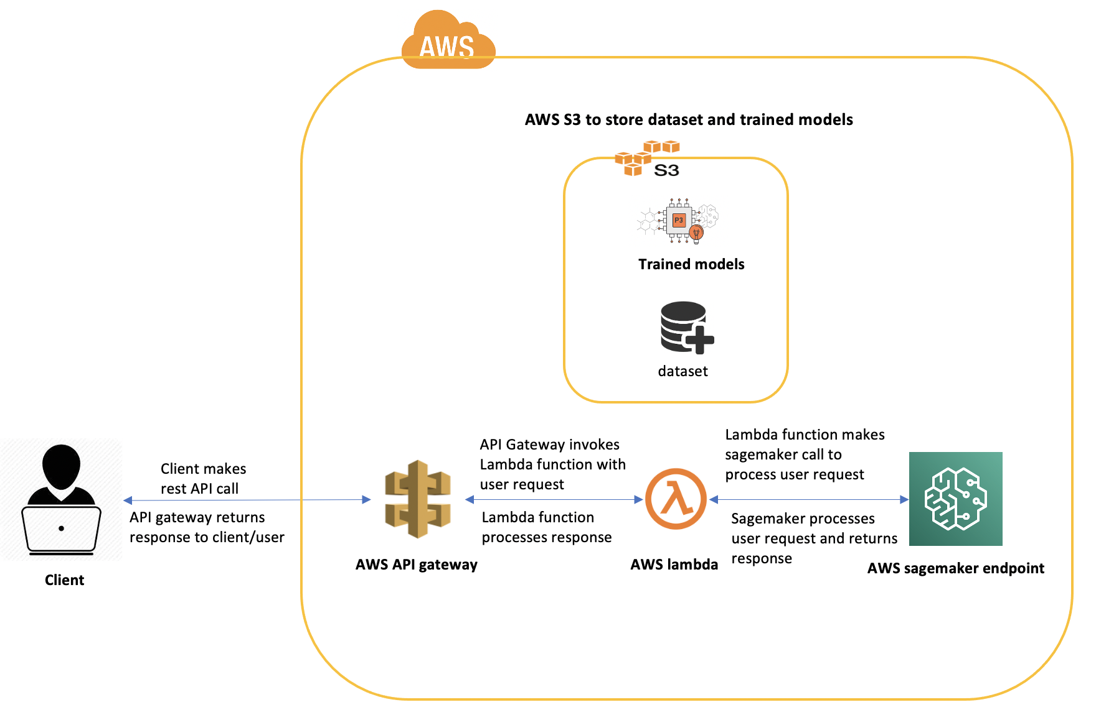
Methods and Approaches
CS 598/Team 1233

Slide 7
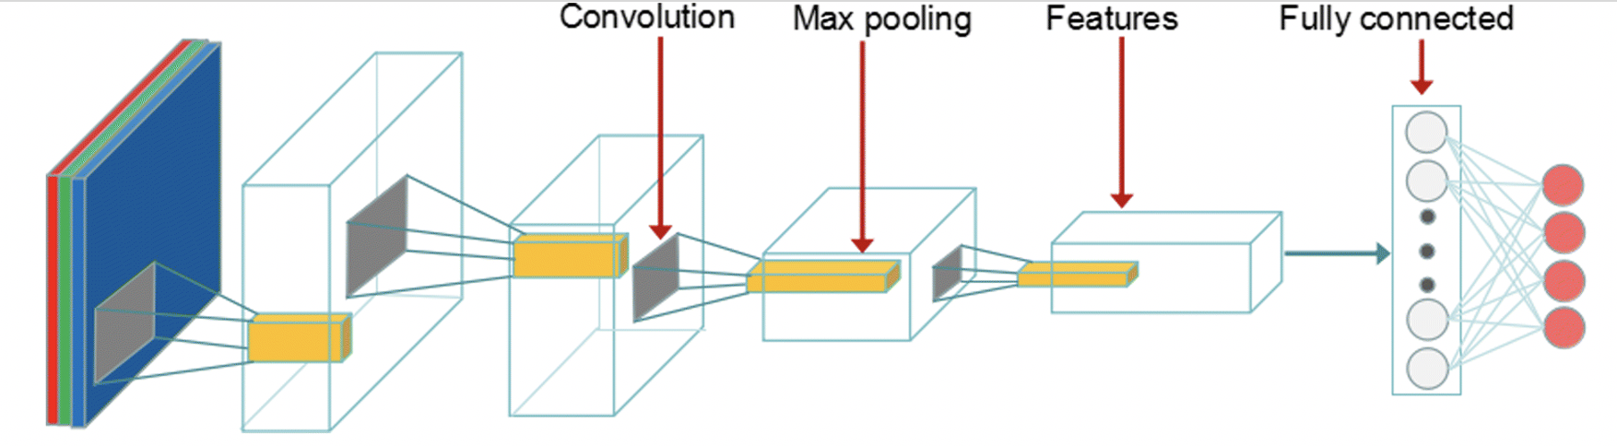
Methods and Approaches
ResNet50 Model Architecture
CS 598/Team 1233

Slide 8
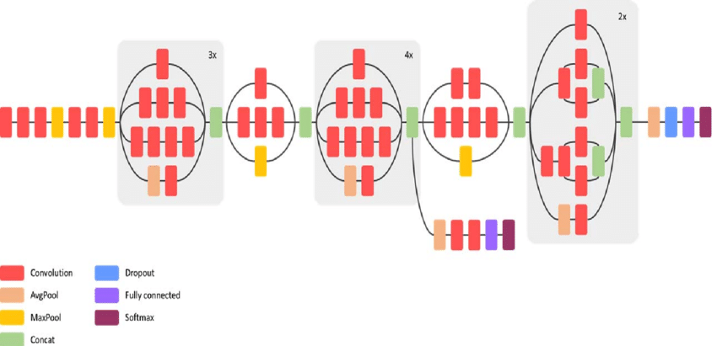
Methods and Approaches
Inception V3 Model Architecture
CS 598/Team 1233

Slide 9
Results
CS 598/Team 1233

Slide 10
Discussion
CS 598/Team 1233

Slide 11
Summary
CS 598/Team 1233

Slide 12
References
CS 598/Team 1233

Slide 13
Summary
Thank You
Questions
Contact Information
Michael Alpas, Mohit Singh, Upendra Yadav, Wasique Ahmad
CS 598 / Team 1233

